Slide 1
This Slide Has Been Intentionally Left Blank

Slide 2




Paul Michaels
@paul_michaels
https://www.linkedin.com/in/pcmichaels/
https://www.pmichaels.net/
https://github.com/pcmichaels
Notes:
Ways to contact me

Slide 3
What are ADRs anyway?
An Inexhaustive and Opinionated Guide
Notes:
This is an introduction, not an exhaustive explanation. Also, as with anything, use what works for you – not something that someone has told you – however enigmatic they may be. Although this talk has a .Net flavour, ADRs are not .Net specific

Slide 4


Architecture Decision Record
Think About Your Ideas
Record your thoughts
Notes:
Start with a vague explanation
Forces you to think about the decisions that you make and record them

Slide 5
The Story So Far…

Slide 6

Functional Specifications
Notes:
When I started in 1997 we used to have functional specifications – large tomes saying what a system should do. They were, essentially, dead as soon as they’d been written.

Slide 7
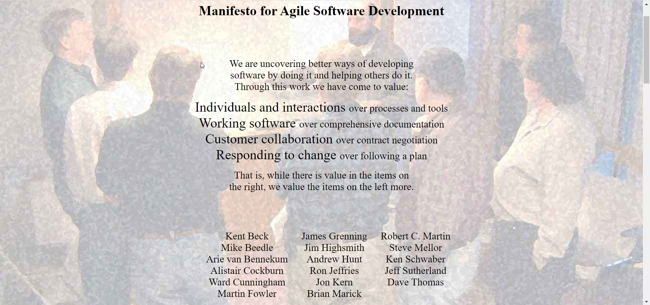
Agile Manifesto
Notes:
In 2001, the Agile Manifesto appeared.
Essentially says: talk to each other.

Slide 8
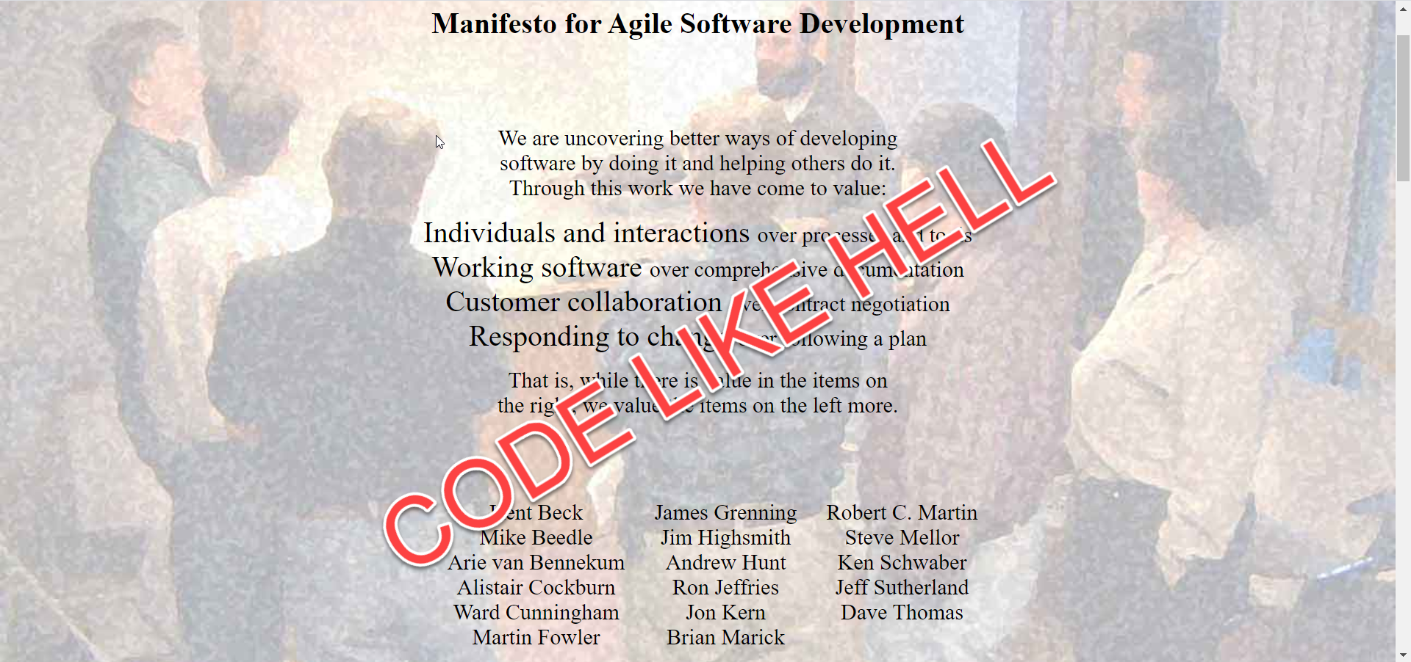
Agile Manifesto
Notes:
Really means…

Slide 9
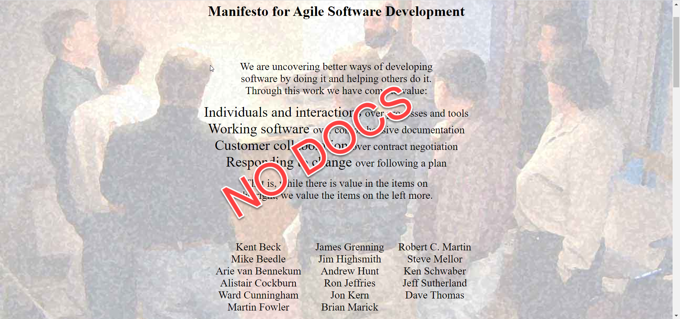
Agile Manifesto
Notes:
Don’t need documentation

Slide 10
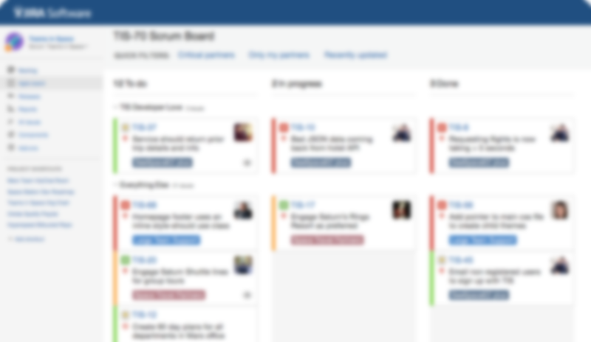
The New Way
Notes:
Who recognises this?
Atlassian and the Scrum Alliance are in cahoots.
Scrum circa 1990
Scrum Alliance: 2001
Documentation now happens in Jira Tickets – but how many people are able to retrieve this information? Have to look through commits, hoping to find a useful commit comment that is linked to the correct Jira.
Even if you find it, it will probably only explain the requirement, not any decisions that are made

Slide 11
The What, When, Why and How…
Not necessarily in that order

Slide 12
What is an ADR - exactly?
A document that can be viewed using the tools with which you normally write code
Markdown
Plain Text
Don’t put word documents in your repo
Let’s see a sample template…
Notes:
Word docs, excel, powerpoint, etc – require a third party tool to view them

Slide 13
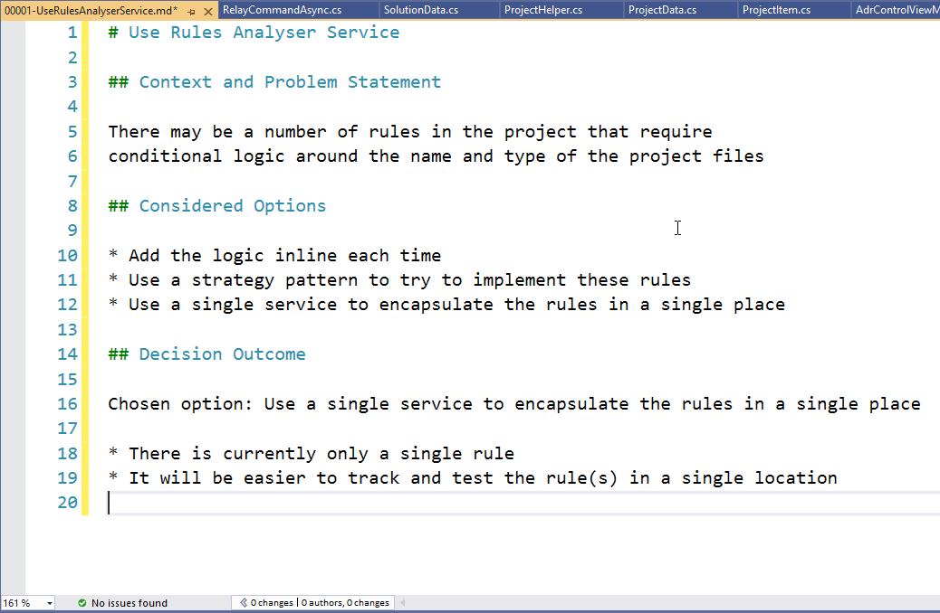

Slide 14
When should you create an ADR?
Any decision that is Architecturally Significant
The Choice of ORM
Deciding to use an API, or an Azure Function
The decision to use a specific testing framework, or a decision to adopt a testing strategy
Sometimes, this can be the decision to NOT do something
Notes:
When should you use ADRs?
What is Architecturally Significant – imagine that you’ve never seen your solution, you don’t know the business domain and you don’t understand the technology. Architecturally Significant is the part where you say: “but why have you done it like this?” The idea here is that you’re recording these reasons so that you don’t have a conversation in 6 months where you say: “we did have a reason for this – I just can’t remember what it was.”

Slide 15
Where should you keep your ADRs?
In your solution
Should be part of your source code
Version controlled
Visual Studio screenshot…
Notes:
What is Architecturally Significant – imagine that you’ve never seen your solution, you don’t know the business domain and you don’t understand the technology. Architecturally Significant is the part where you say: “but why have you done it like this?”

Slide 16
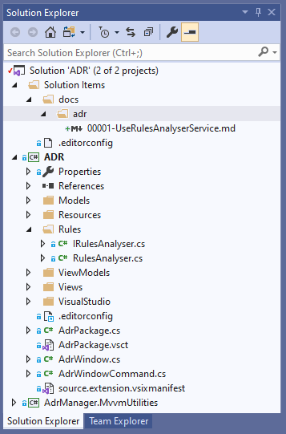

Slide 17
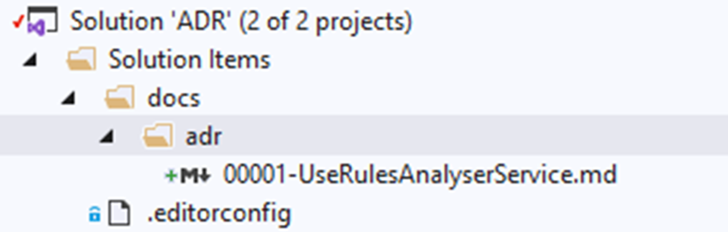

Slide 18
Thank you
http://thinkrelevance.com/blog/2011/11/15/documenting-architecture-decisions
https://adr.github.io/
https://en.wikipedia.org/wiki/Architecturally_significant_requirements
Notes:
Some links to ADR in its various guises

Slide 19
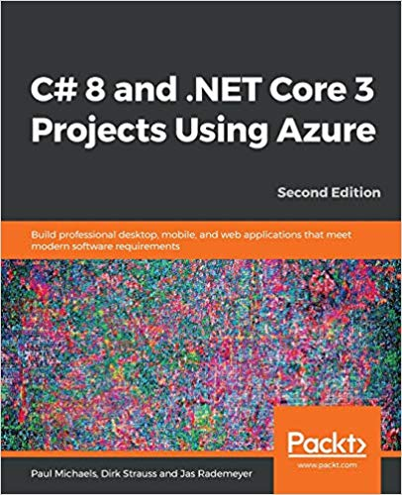
Thank you
https://github.com/pcmichaels/ADRManager
https://github.com/pcmichaels/AdrTalk
https://www.packtpub.com/web-development/c-8-and-net-core-3-0-projects-second-edition
Discount Code: azure20
https://www.amazon.co.uk/gp/product/178961208X/
Discount Code: 20AZURE
Notes:
ADRManager – VS Plug-in that manages the ADRs in your solution
Git Hub repo for these slides
My book + discount codes

